Slide 2
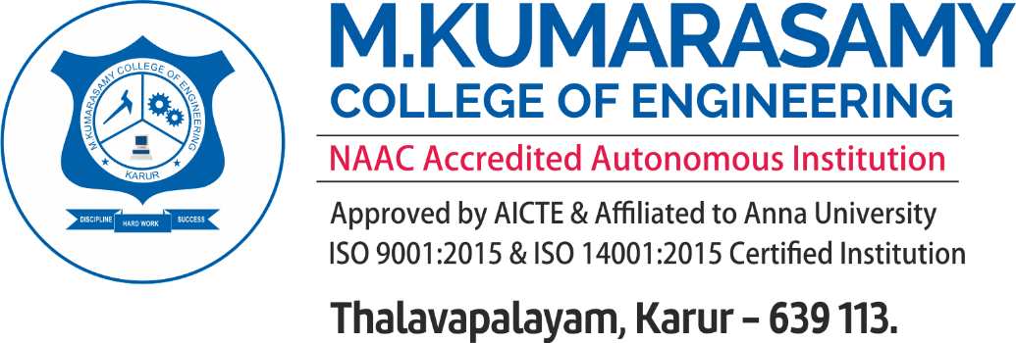
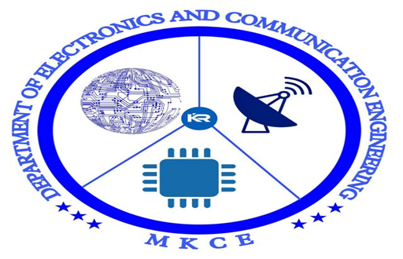
object weight measurement using iot protocol with mobile application
ELECTRONICS AND COMMUNICATION ENGINEERING
TEAM MEMBERS :
SHOBIKA S (927621BEC198)
SURIYA N (927621BEC224)
VAISRI S (927621BEC233)
VASUKI M (927621BEC236)
GUIDED BY:
Dr.S.MEIVEL AP/ECE

Slide 3
Contents:
INTRODUCTION
PROBLEM STATEMENT
OBJECTIVE
EXISTING SYSTEM
REFERENCES
CONCLUSION

Slide 4
Introduction:
The integration of Internet of Things (IoT) protocols with mobile applications has ushered in
transformative possibilities across various domains.
One such application lies in the realm of object weight measurement, where the convergence of
IoT and mobile technology offers innovative solutions.
This synergy facilitates real-time monitoring, data collection, and seamless user interaction,
revolutionizing traditional weight measurement methods.

Slide 5
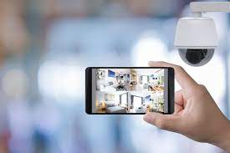
Problem statement:
Security
Existing weight measurement processes lack real-time monitoring and precision, leading to inefficiencies in logistics, healthcare etc..
developing an IoT-based system with a mobile app for accurate and instant object weight measurement, ensuring improved efficiency, accessibility, and data-driven decision-making in diverse industries
There is a growing need for innovative solutions that seamlessly integrate Internet of Things (IoT) protocols with mobile applications to address real-world challenges.

Slide 6
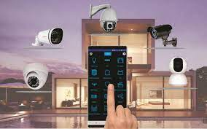
OBJECTIVES :
To design and implement a comprehensive system that utilizes IoT protocols for
precise and real- time object weight measurement.

Slide 7
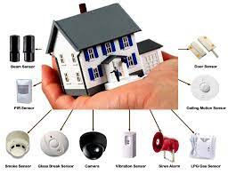
Existing system:
Existing solutions for object weight measurement often rely on traditional weighing systems that
lack real-time monitoring and connectivity features.
Manual methods can be error-prone, leading to inefficiencies in industries such as logistics and
healthcare, the integration of IoT protocols with mobile applications has started gaining attention, but
current implementations may lack a standardized and scalable approach.
There is a need for a more cohesive and user-friendly solution that seamlessly combines IoT
technology with mobile interfaces, providing accurate, timely, and accessible object weight data for
improved decision-making and operational efficiency.

Slide 8
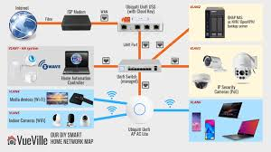
REFERENCES :
Abdesalam. M, Al_Issa.H.A ,Thuneibat.S ,“Sensors Application Using PIC16F877A Microcontroller,” American
Journal of Remote Sensing, vol. 4, no. 3, pp. 13-18, 2016.
Abraham .J, Habeeburahman.C.A, Hareesh.K.S, Jithin.K.K, Thomas.R.P, “Range Detection Based on Ultrasonic
Principle,” International Journal of Advanced Research in Electrical, Electronics and Instrumentation Engineering,
vol. 3, no. 2, pp. 7638-7642, 2014.
Aldoulah.Z.A, “Application of Ultrasonic Radars in a Real-time Distance Detection System for Individuals with
Visual Impairment,” M.S. thesis, Department of Electrical Engineering, The University of Toledo, USA, 2017.
Alessio Carullo and Marco Parvis,”An ultrasonic sensors for distance measurement in automotive
application”,IEEE Sensor Journal,2001.

Slide 9
Conclusion:
In IoT protocols with mobile applications in object weight measurement exemplifies the evolving landscape of smart technologies.
As we move forward, the continued exploration and refinement of these technologies hold the promise of further advancements in precision, connectivity, and usability, ultimately contributing to a more interconnected and data-driven world.
The object weight measurement through IoT and mobile application stands as a testament to the ongoing convergence of cutting-edge technologies, shaping a future where efficiency and convenience coalesce seamlessly.

